Slide 1
INTO THE VOID hiv exposed uninfected adolescents – A Review
Prof Lorraine sherr ucl London
No conflict of interest to report

Slide 2
WHO ARE THE HIV EXPOSED UNINFECTED ADOLESCENTS?
HIV+ve mother
HIV in the family
ART treatment in pregnancy
Maternal HIV diagnosis in pregnancy
Shock/ Trauma
Depression/Anxiety/ Suicidal ideation
Parental illness
Parental death
Stigma
Secrecy
Economic hardship
Distracted parenting
10-19 YEAR OLDS
Born to HIV infected mother between 1999-2008
What about those born to HIV+ve fathers?
WHAT ELSE ARE THEY EXPOSED TO :

Slide 3
WHERE IS THE LITERATURE?
Small body of literature on HEU
Skewed to Biomedical and
High Income Countries
Skewed to younger ages
Larger literature Buried
General adolescent
HIV+ve caregivers
Orphan VC
HIV+ve

Slide 4
Estimates – unaids 2018

Slide 5
Biomedical
Psychological
In the body
HEU – biological exposure to virus and ART
In the mind
In the behaviour
In the relationships
In the home
In the community

Slide 6
Concepts studied
Biomedical – not the focus of this overview
Cognitive/development
Language
Memory
Executive functioning
Mental Health
Suicidal Behaviours
Quality of life
Substance Use
Psychological adjustment, behaviour
Disclosure
Violence
Care
Police arrests and Underachievement
Risk Behaviours
Bereavement
Interventions
Positive Mental Health

Slide 7
1. BIOMEDICAL | HEU DISADVANTAGE?
Health, illness, survival, drug exposure
DENTAL HEALTH (Ryder et al 2017)
CARIES (Coker et al 2018)
MORTALITY (Ruperez et al 2017, Iroh et al 2018)
PULMONARY INFECTIOUS DISEASE MORBIDITY (Pierre et al 2016, Shearer et al 2018)
PERTUSSIS (Du Plessis 2018)
HEARING LOSS (Torre 2012)
CANCER (Hleyhel et al 2017)
CARDIAC (Wilkinson 2018 Guerra 2016)
IMMUNISATION (Siberry et al2015)
TUBERCULOSIS Cranmer 2018, Mandalakas et al 2015)

Slide 8
OVERALL Mortality

Slide 9
2. COGNITIVE Development Language, Memory, Executive functioning

Slide 10
SYSTEMATIC REVIEWS, meta-analysis and multisite studies
Filteau et al 2010
La Dore et al 2012. Under 16. Younger HEU delay, older near normal - Unclear.
Sherr et al 2014
Boivan et al 2018 Six hundred and eleven (246 HIV+, 183 HEU, 182 HUU) of the 615 enrolled at six sites [South Africa (three), Zimbabwe, Malawi, Uganda] HEU and HUU performed similarly.
New York Mellins et al

Slide 11
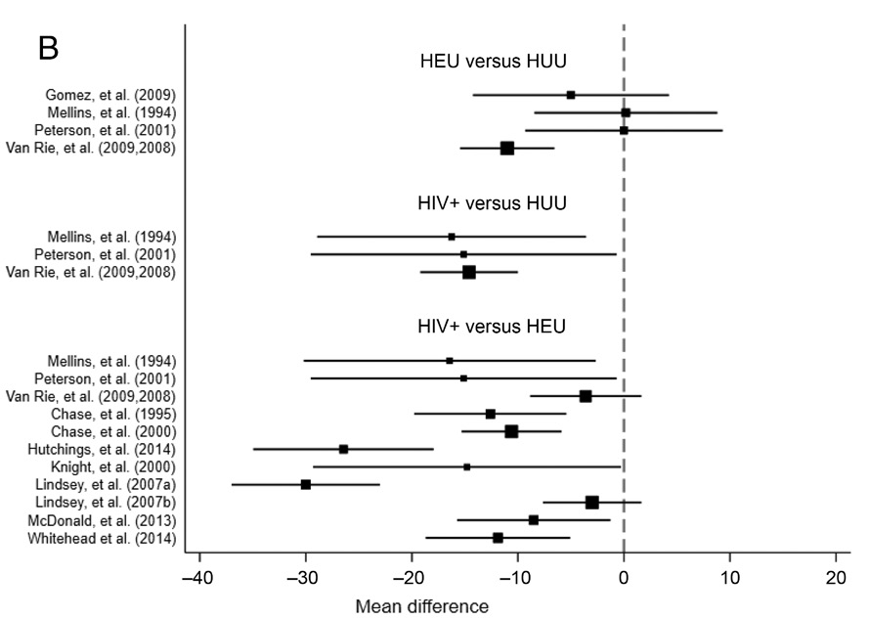
Meta-analysis Mchenry et al 2018 CONFINED TO <8 Years
45 studies Identified 3 HEU data
Both HIV+ and HEU children showed worse cognitive and motor outcomes
Compared with HUU children. Both HIV+ and HEU children exposed to ARV medications may also have worse cognitive development

Slide 12
12 studies 279 HIV+ve, 873 HIV affected 827 control. 7/12 lower achievement (Sherr et al 2014) NO ADOLESCENTS

Slide 13
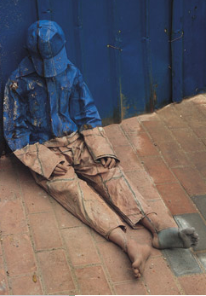
Cognitive development ii

Slide 14
UPDATE
Studies more detailed –
Looking at sub domains (eg language Redmond et al 2016), memory (Nichols et al 2016), executive functioning (Nichols et al 2015)
Looking at broader factors
ARV exposure
Compound exposure
Breast feeding
Prematurity
Biomarkers and neurodevelopment (Kapetanovic S et al 2014)
Associations of memory and executive functioning with adaptive functioning (Sirois PA et al 2016)
Ethics Jao et al 2016, Klitzman 2016
Still dearth of studies on adolescents

Slide 15
STUDY | DETAIL | ADOLSCENTS 10-19 YEARS?
Sherr 2014 | Systematic review, Cognitive development 11 studies | NO
Arikawa et al 2016 | Review mortality 14 Studies | NO
Harris et al 2017 | Prospective memory, n=85 HEU | YES
Chaudhary 2018 | 598 HEU | NO
Rice 2017 | ages 3 (N= 208) and 5 (N = 429) years | NO
Le Roux et al 2018 | N=521 | NO
Ezeamama et al (2017)Uganda | Long term follow up in Uganda | YES
Chaudhury 2017 Botswana | N=670 | NO
Benson et al 2018 | Psychiatric, substance use, sexual behaviour | YES
Sanmaneechai 2004 | 35 HEU Thailand | NO
Kerr et al 2014 Thai/Cam | 160 HEU 167 HUU | NO

Slide 16
Wu 2018 | 250 HEU China | NO
Abubakar et al.(2009) | 367 children (31, HIV+, 17 HEU, 319 control | NO
Smith et al 2017 | N=64 | NO
Brahmbhatt H et al (2017) | 370 children, 140 HIV, 26 HEU and 204 HUU | YES
Van Rie et al. (2008) DRC | 160 children 18–72 months (35 HIV+, 35 HEU, 90 control | NO
Whitehead et al 2014 (SA) | 29 HIV+ve, 25 HEU | NO
Baker et al. (2012) USA | 70 children (21 HIV+, 24 affected, 25 asthma | YES
Chernoff et al. (2009)USA | 575 children 6–17 yrs (319 HIV+, 256 affected | YES
Gadow et al. (2012) USA & Puerto Rico | 278 children 6–17 yrs (157 HIV+, 121 affected) | YES
Malee et al. (2011)USA & Puerto Rico | 416 children 7–16 yrs (295 HIV, 121 affected | YES
Rice et al. (2012) USA & Puerto Rico | 437 children 7–16 yrs (284 HIV+, 153 affected) | YES
Nichols et al (2016) USA | 258 children 9-19 years (HIV 173, HEU 85) | YES
Malee et al (2017) USA | 223 (HIV=144, HEU=79) | YES
Serchuck et al.(2010) USA Puerto Rico | 576 children 6–17 yrs (320 HIV+, 256 HEU/control) | YES
Sirois et al (2016) USA | 258 youth | YES
Milligan et al 2017 | HIV+ve n = 95), HEU n = 86) HUU n = 92) | NO

Slide 17
3. MENTAL HEALTH
Depression, anxiety, trauma, suicidality, stress, syndemic
Mutumba 2016 USA
For HEU specifically gleaned from this study
Changes in Mental health varied with age, sex, negative life events and neighbourhood stress.

Slide 18
4. SUICIDAL BEHAVIOURS
Ideation, Thoughts, Acts, Completions
Burdensome as well as an index of depression
Leading cause of mortality
Gender differences
Cluver Orkin Boyes and Sherr (2015)
3,515 adolescents aged 10 -18 years in South Africa (56% female; <2.5% refusal).
Past-month suicidality rates were 3.2% of adolescents attempting, 5.8% planning, and 7.2%reporting ideation.
Orphanhood by AIDS 12.5 (m) 13.6 (f)
Parental AIDS-illness 28.1 (m) 33.5 (f)

Slide 19
Caregiving environment of hiv on suicidal ideation and psychological morbidity (CCs Sherr et al 2016)

Slide 20
5. QUALITY OF LIFE
Quality of life predictor of many outcomes
Good validated measures
Wellbeing important
Not routinely measured
Nkwata AK ET AL 2017 HIV HEU AND HUU
HEU and HUU had similar QOL profile but PHIV predicted sustained deficits in multiple QOL domains.
HIV and HEU children were similar with respect to general wellbeing and present functioning.

Slide 21
6. SUBSTANCE USE
Widespread use
Affected by parental substance use
Associated with risk behaviour either as a trigger or a cluster
Benson et al 2018 HIV+ve and HEU Youth (USA)
Substance use and behaviour disorders were correlated with either ever having had penetrative sex or recent condomless sex for participants with prenatally acquired HIV infection only

Slide 22
7. PSYCHOSOCIAL ADJUSTMENT and behavior
Adjustment
Behaviour
Zalawango et al 2016 Uganda
58 HIV, 56 HEU, 54 HUU
positive outlook (β=-4.3, 95% CI: -7.3, -1.2) and self-esteem lower for HEU versus HUU. Hopelessness similar. Distress and depressive symptom levels comparable for HEU and HUU.
Weerdt et al 2017 - N=1,108 from Kagera Tanzania Follow up 16-19 years ; 531 (36%) lost 1 or both parents
Self esteem sig affected for paternal loss.
Via socio-economic pathways
Hemetet-Lindsay et al 2017 USA
Among both HIV+ve and HEU, higher caregiver-child stress predicted worse Behavioural functioning.
Higher youth cognitive functioning was associated with better caregiver-reported behavioural functioning in both HIV and HEU groups.
Caregiver resources predicted caregiver-reported BF in PHEU youth, which was mediated via youth CF.

Slide 23
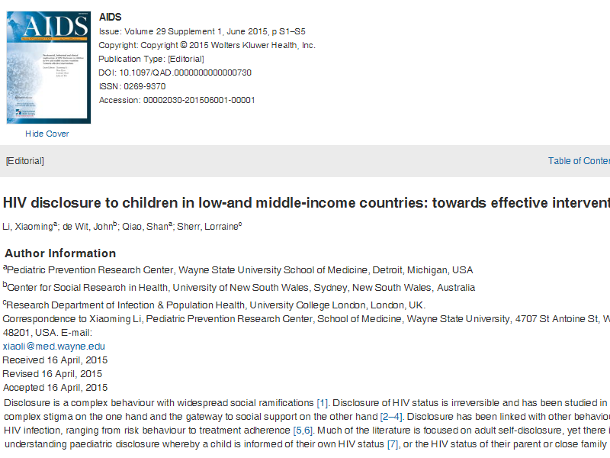
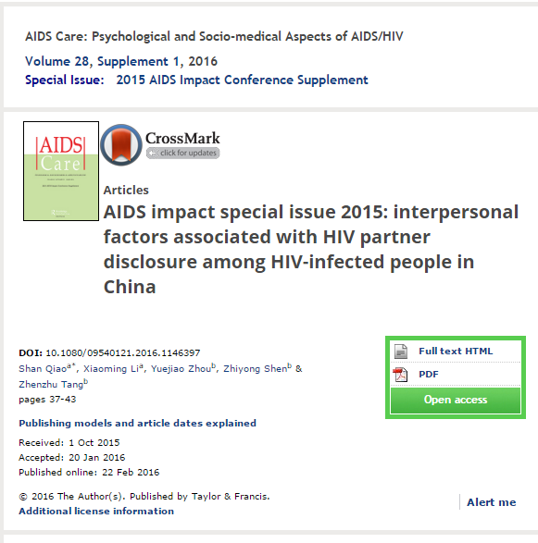
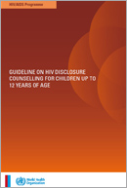
8. Disclosure
Child status
Parent status
WHO Guidelines
Optimal age (DaBaets 2009, WHO 2012) 13 Regrets (11 studies) few child, parent preparation
Emotional reactions
Expected > actual
Affects behaviour, adherence, Interventions (see special issues AIDS and AIDSCare)
Rochat RCT SA 2017 (Lancet)

Slide 24
9. Violence
At baseline exposure to violence impacted children’s psychological wellbeing.(Sherr et al Community Care Study)
Domestic violence
Child depression
Trauma symptoms
Harsh physical discipline
Problem behaviours
Self-esteem
Community violence
Harsh psychological discipline
Problem behaviours
Self-esteem
Problem behaviours
Self-esteem
Trauma symptoms
Problem behaviours
Notes:
Title Page

Slide 25
10. CARE
Out of family care
Orphan issues
Orphanage issues
Alternative care provision
Family care
Fathers and Mothers
Grandparenting
Population living with HIV infected adults (Systematic review Goldberg et al 2016)

Slide 26
Mental health of caregiver
Above cut off - n=470; below the cut off n=246.
Physical Violence
Psychological Violence

Slide 27
11. Underachievement and POLICE ARRESTS
Police Arrests
Underachievement
Elkington et al (2017) USA
No difference by HIV status (HIV, HEU)
Arrest rates high – increasing over 7 year follow up
from 2.6 to 19.7%
Predictors were Male, out of school and unemployed.
GARVIE et al 2014

Slide 28
12. BEREAVEMENT
Honest and open communication is needed to avoid complicated grieving (Woolett et al 2017)
Burden of bereavement
Lifelong
Legacy of AIDS related parental death
Bereaved children – functioning challenge
Combined bereavements – multiple burden – toxic shock
Psychological, financial, social ramifications.
Thurman et al – Lancet 2017. Bereavement intervention efficacy of a short term intervention in South Africa.

Slide 29
13. RISK BEHAVIOURS
EFFECTS OF ABUSE, POVERTY & PARENTAL AIDS ON FEMALE ADOLESCENT RISK OF TRANSACTIONAL SEX

Slide 30
14. Are there interventions?

Slide 31
overview
Treat parental depression and mental health - Good evidence of benefit
Borus Philani trial
Nutrition Good evidence of benefit
Support Good evidence of benefit
ART - Parental survival Good evidence of benefit
Cash grants - Good evidence of benefit
Cash plus care - Good evidence of benefit
Cognitive rehearsal Good evidence of benefit
(Boivan et al),
Systematic review – Sherr et al 2014
Stimulation - Good evidence of benefit
Tomlinson book sharing, Walker long term (Jamaica)
Parenting - Good evidence of benefit
Sinovuyo, ICDP, Incredible years etc…
Community Support (CBO) Good evidence of benefit
Disclosure Good evidence of benefit
Amagugu (Rochat et al 2017) 6-10 year olds

Slide 32
Psychosocial support
King report 2009 no single evaluation
Skeen et al 2017 – 17 met criteria 15 showed effective interventions
1. CBOs

Slide 33
Cash transfers- Good evidence of benefit
Zomba (Baird et al): reduced HIV-prevalence for both school-conditional and unconditional
HTPN068 (Pettifor et al): reduced HIV-risk behavior but high school attendance and low HIV-incidence overall
CAPRISA007 (Abdool Karim et al): reduced HSV-2 but low HIV-incidence overall
Kenya OVC (Handa et al): reduced sexual initiation and pregnancy, no HIV biomarkers.
South Africa (Cluver et al) associated with reduced risk behaviour and better adherence
South Africa and Malawi (Sherr et al) associated with educational and cognitive outcomes

Slide 34
Cash + care and Cognitive ability Sherr et al 2017 BMC PEDIATRICS)
Draw-a-person,
F(3)=52.31, p<.001.
Digit span
F(3)=10.67, p<.001

Slide 35
15. Positive mental health
Resilience
(Betancourt, Skovdal, Sherr)
Coping
Adjustment
Post traumatic growth

Slide 36
Growing evidence
Failure to track
Adolescents data needed
Integrated behaviour, mental health & biomedical
HEU future

Slide 37
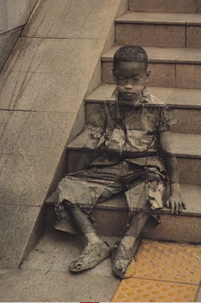
THANK YOU

Slide 38
Child depression was significantly reduced for those with no parental depressed mood, and those with HIV only
For those with comorbidity (HIV+ and depressed mood), depressed mood in the child increased over time.

Slide 39
CBO attendance predicts better outcomes
Abuse
OR: .11***
Domestic violence
OR: .22**
OR: .41*
Suicidal ideation
CBO contact
B: -.40*
Depression
B: -.40***
Stigma
B: -1.08***
Peer problems
B: -.77***
Conduct problems
Sherr L et al (2016). How effective is help on the doorstep? A longitudinal evaluation of CBO support on child behaviour and mental health. PlosOne.
B: 1.40***
Prosocial behaviour
Notes:
The second questions was: is CBO attendance associated with better outcomes?
Children who were in contact with CBO since 2012 showed better outcomes compared to the non-attenders. These effects persisted over time.

